Slide 1

Identification Of Misinformation for Cannabis Medical use on Twitter
Leyla Elnaggar
Parth Paliwal
Suhail Shaikh
Vaishnavii Paramashivam

Slide 2
IntroductioN
With the spread of fake news and false information, more and more social media platforms are looking for ways to filter data that is being shared on those platforms.
Our project is inspired from the idea of building an ontology data model, where we have collected a large set of tweets from Twitter that are related to medical Marijuana.
Afterwards we contrast those tweets against a set of facts about medical Marijuana that we obtained from literature review articles, and we label this tweet with, either verified or unverified based on the content of that tweet.

Slide 3
Objective
Primary objective(content analysis):
To identify verified/unverified facts regarding the use of cannabis for medicinal purposes on Twitter.
Secondary objectives(source analysis):
Classify tweets generated by social bots versus those from non-bot accounts
Identify behavior of bots making health claims about Cannabis

Slide 4
MOTIVATION
Laws permitting the use of Cannabis for medical and recreational use in many states across US, has lowered prices and increased the availability of cannabis.
Marijuana is legal in 11 states for adults over the age of 21, and legal for medical use in 33 states.
Misinformation and repeated use of cannabis can cause some health implications.
Some Health Outcomes
Impaired short-term memory
Impaired coordination & attention
Repeated Cannabis Use could lead to
Addiction
Increased risk for other substance abuse

Slide 5
Tweets Content Credibility model Phases
Phase 1: Identify cannabis related tweets.
In this phase we created a list of key terms that are related to cannabis.
We collected those terms from different papers. The purpose, is to capture as many tweets as possible that have any mention of cannabis in any form.
- Our list had 31 cannabis related terms.
- This list is attached with our project.

Slide 6
Continued..
Phase 2: Collecting Medical claims
- After collecting all the tweets with cannabis related terms we collected a list of verified medical benefits in regards to the use of medical Marijuana.
- This data will be used in order to help us label, those tweets that have a verified medical content of cannabis usage or benefits.
We based our selection of verified medical claims:
Diseases proven to benefit from cannabinoids based on Randomized clinical Trials(RCTs) double blinded trials.
FDA approved medicinal cannabinoids.
Research results from National Institute of Health (NIH)
- Our facts sheet included 11 proven medical claims for Cannabis.

Slide 7
Continued…
Phase 3: Creating Buckets of words (keywords lists)
- In this phase we have created several bag of words or buckets that would later be used to create our semantic content connections for a tweet.
- Those buckets will be used to filter our initial dataset of cannabis tweets to identify which tweets contain medical claims.
- And later on filter those further to which of those claims are verified medical claim in order to label our tweet as such.

Slide 8

Building our Model

Slide 9
METHODS USED
Data Collection
Data Screening
Identifying Social Bots
Programming Language | API Used
Python | GetoldTweets3
Programming Language | Method Used
Python | 3 phase bag of words classifier
Programming Language | Package Used
R | Tweetbotornot2

Slide 10
METHODS USED
Identifying Promotional Tweets
Identifying Facts/Unverified Facts
Extracting URLs, User Mentions
Programming Language | Method Used
Python | Keyword based Classifier
Programming Language | Method Used
Python | User Defined Classifier using 3 bag of words
Programming Language | Package Used
Python | NLTK, re

Slide 11
Data Collection
Package used:
Used “GetoldTweets3” package available in python to collect tweets as Twitter Official API has the bother limitation of time constraints and we cannot get older tweets than a week.
Keywords used:
Initially extracted all tweets which consisted of following cannabis related keywords for given time period:
cannabisedibles, marijuana, cannabis, weed, joint , blunt, mary jane, bong, budder, cbd, ganja, hemp, indica, kush, marihuana, sativa, thc, edibles, bud, weededibles, recweed, medweed, medicalmarijuana
Time period:
Collected tweets for 5 months starting from Nov 2019- March 2020.
Initial sample:
Initially extracted 380000 tweets using above Cannabis related keywords.

Slide 12
Medical Conditions & Effects bucket
The basic premise of the filtering is to get relevant tweets making health claims of using Cannabis
For example tweet “Marijuana heals cancer cells” will have:
term “Marijuana” from the Cannabis bucket
“Heals” as an action word from the Effects bucket
“Cancer” from the Medical Conditions bucket
Since above tweet has keywords from all 3 buckets it will be further selected for our analysis.

Slide 13
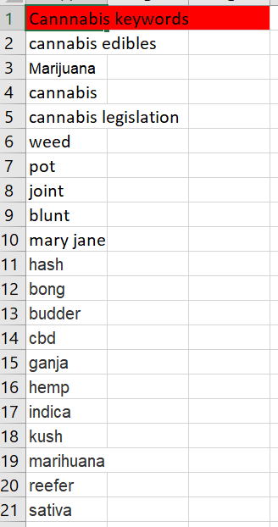
Data Screening
Our data screening constituted filtering tweets in 3 Stages:
Stage 1: Cannabis Related Terms – 31 words
Collected 380000 tweets which has keywords from “Cannabis” as shown in the following table.

Slide 14
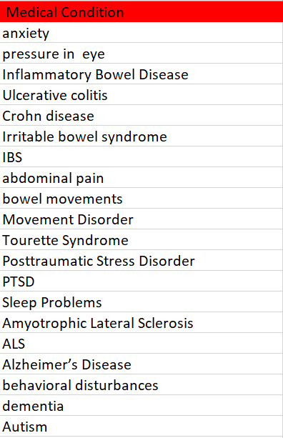
Continued…
Stage 2: Medical Conditions Bag of Words – 963 words
Filtered and removed tweets which do not have any of the keyword from the “Medical Conditions” Bag of words and reduced count of tweets from 380000 to 7638
The following snapshot shows a sample of the key terms used to filter tweets with medical conditions

Slide 15
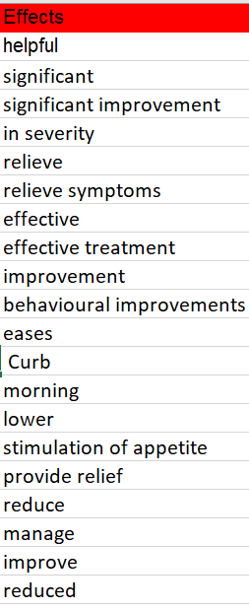
Continued…
Stage 3: Treatment Bag of Words – 300 words
The “Effect” Bag of words is important as it claims effect of using Cannabis in certain medical condition
So have we removed tweets which do not mention “Effect” of using Cannabis for a certain medical condition.
And reduced count of tweets from 7638 to 2588.

Slide 16
AN Example of our targeted Tweets
Continued …
This is an example of our target tweets that we wanted to collect in our dataset:
“Marijuana heals cancer cells”
The tweet constitutes the following:
term “Marijuana” from the Cannabis bucket
“Heals” as an action word from the Effects bucket
“Cancer” from the Medical Conditions bucket
Since above tweet has keywords from all 3 buckets it will be further selected for our analysis.

Slide 17
DATA PREPROCESSING
Package used- NLTK (natural Language toolkit, a package in Python for natural language processing)
Remove links
Convert tweet text to lowercase
Remove punctuations
Remove numbers
Removed Re-tweets
Non-printable character removal e.g., emojis and symbols from other languages

Slide 18
Bot or Non-Bots
Tweets Source Analysis

Slide 19
IDENTIFYING TWITTER BOTS
Tool Used – TwitterBotOrNot2
Reference - https://ajph.aphapublications.org/doi/pdf/10.2105/AJPH.2019.305461
Researchers at USC analyzed tens of thousands of tweets and found that social bots frequently shared false information about cannabis’s medicinal benefits

Slide 20
IDENTIFYING TWITTER BOTS
Tool Used – TwitterBotOrNot2
Reference - https://ajph.aphapublications.org/doi/pdf/10.2105/AJPH.2019.305461
Researchers at USC analyzed tens of thousands of tweets and found that social bots frequently shared false information about cannabis’s medicinal benefits

Slide 21
BOT AND NON-BOTS
We analysed the no of social bots and non-bots on both tweet level and user level.
34 user accounts(1.59%) out of 2128 unique user accounts have been deleted from the time since we started collecting data. Hence, Bot/Non-Bot information for these user accounts are not available and has been categorized as N/A’s
255 user handles were bots contributing to 822 tweets.
TWEET LEVEL
USER LEVEL
 | Out of 3490 tweets
Bots | 822
Non-Bots | 2627
N/A | 41
 | Out of 2128 users
Bots | 255
Non-Bots | 1839
N/A | 34`

Slide 22
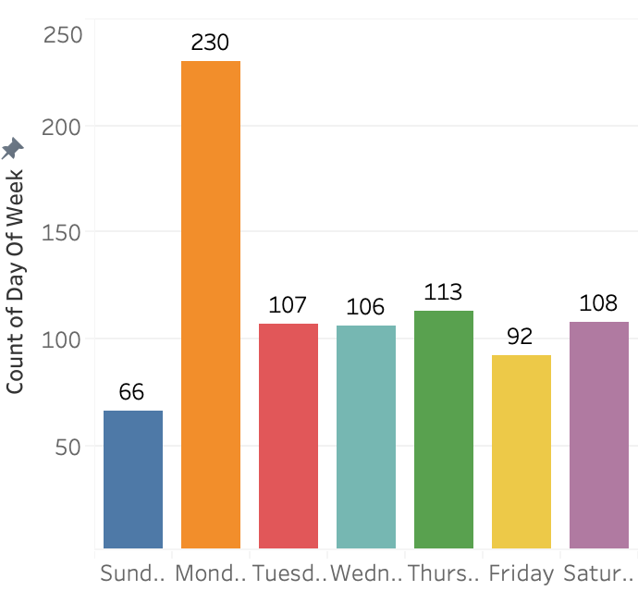
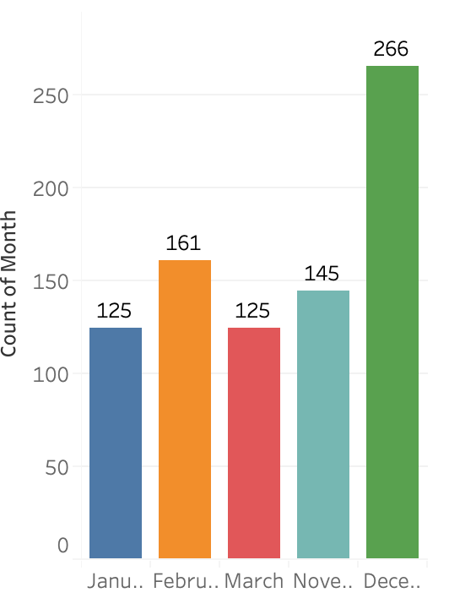
Behavior of bots
Bot Tweets – Daily Basis
We’ve taken the 822 tweets made by Bots to further analyze the behavior of these Bots.
27.9% of tweets made by bots were on Mondays, 13.7% on Thursdays,13.1% on Saturdays, Tuesdays and Wednesdays, 11.1% on Fridays and 8% on Sundays
32.3% of tweets made by bots were in December, 19.5% in February, 17.6% in November, 15.2% in March and January
Bot Tweets – Monthly Basis

Slide 23
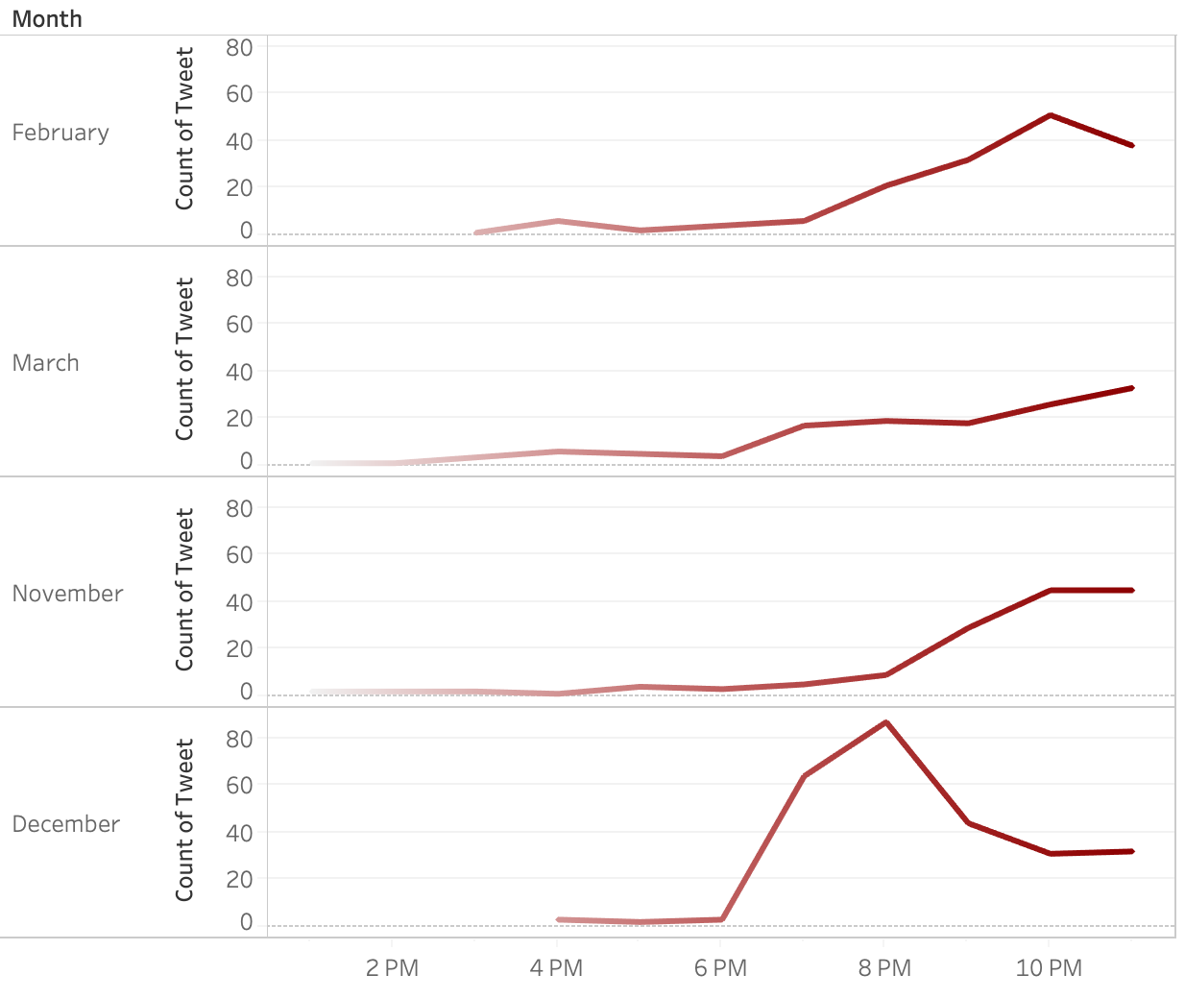
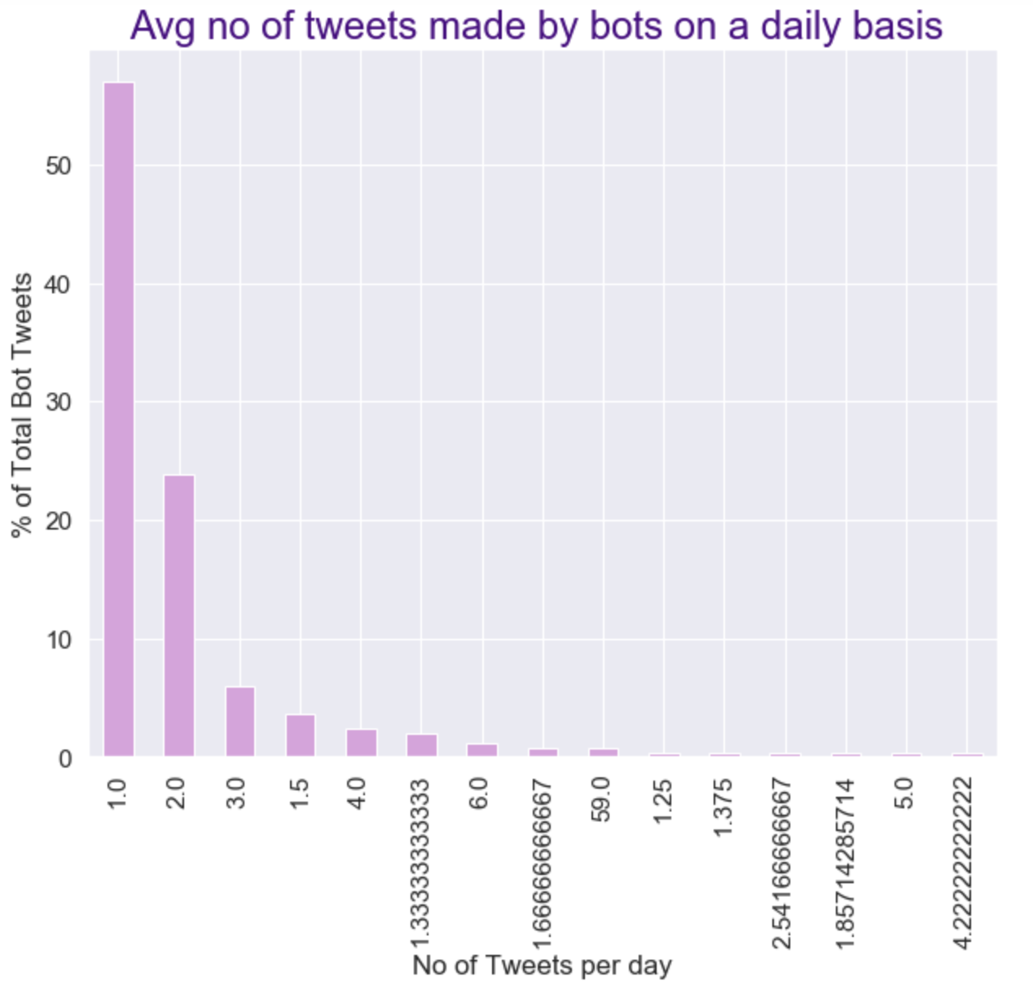
BEHAVIOR OF BOTS
Bot Tweets – Twitter Activity
Bot activity was highest at late night after 6pm
Bots tweeting 1 or 2 tweets per day on average contributed to around 70% of total tweets.

Slide 24
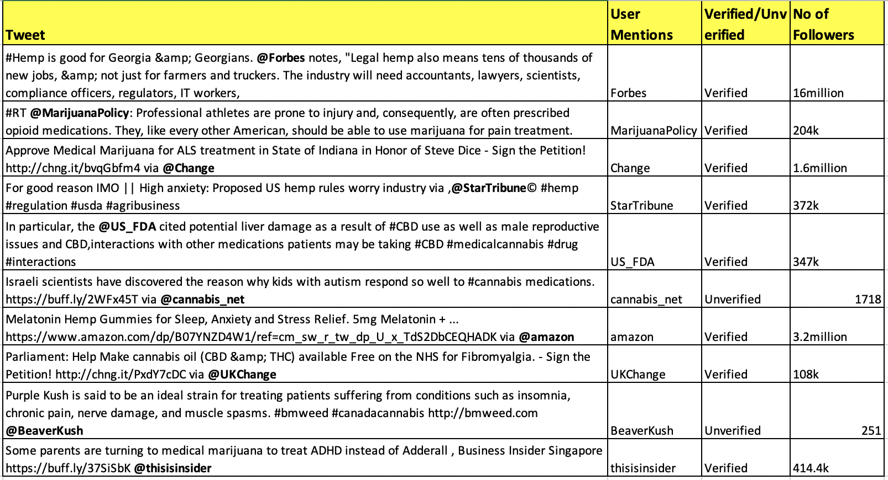
SOURCE ANALYSIS of bots – user mentions
Out of 822 tweets made by Bots, only 497 tweets were unique tweets.
On analyzing the 497 unique tweets to identify the user mentions (@person tagging) , we found that there were 10 unique user mentions.
The information regarding these @ mentioned user accounts – Verified/Unverified twitter account, No of followers was then collected & summarized in the table as shown.
8 out of the 10 unique user mentions were found to be Verified Twitter accounts with more than 100k followers.

Slide 25
SOURCE ANALYSIS of bots - urls
The number of URLs present in the 822 Bot tweets were analyzed and there were 590 tweets which contained URLs.
Out of these 590 URLs 344 unique URLs were observed
The user handles that tweeted the same URL were grouped by the URLs to analyze possible networks among these Bots.
 | No of Tweets (Out of 822 Bot Tweets)
Tweets containing URLs | 590
Tweets containing unique URLs | 344

Slide 26
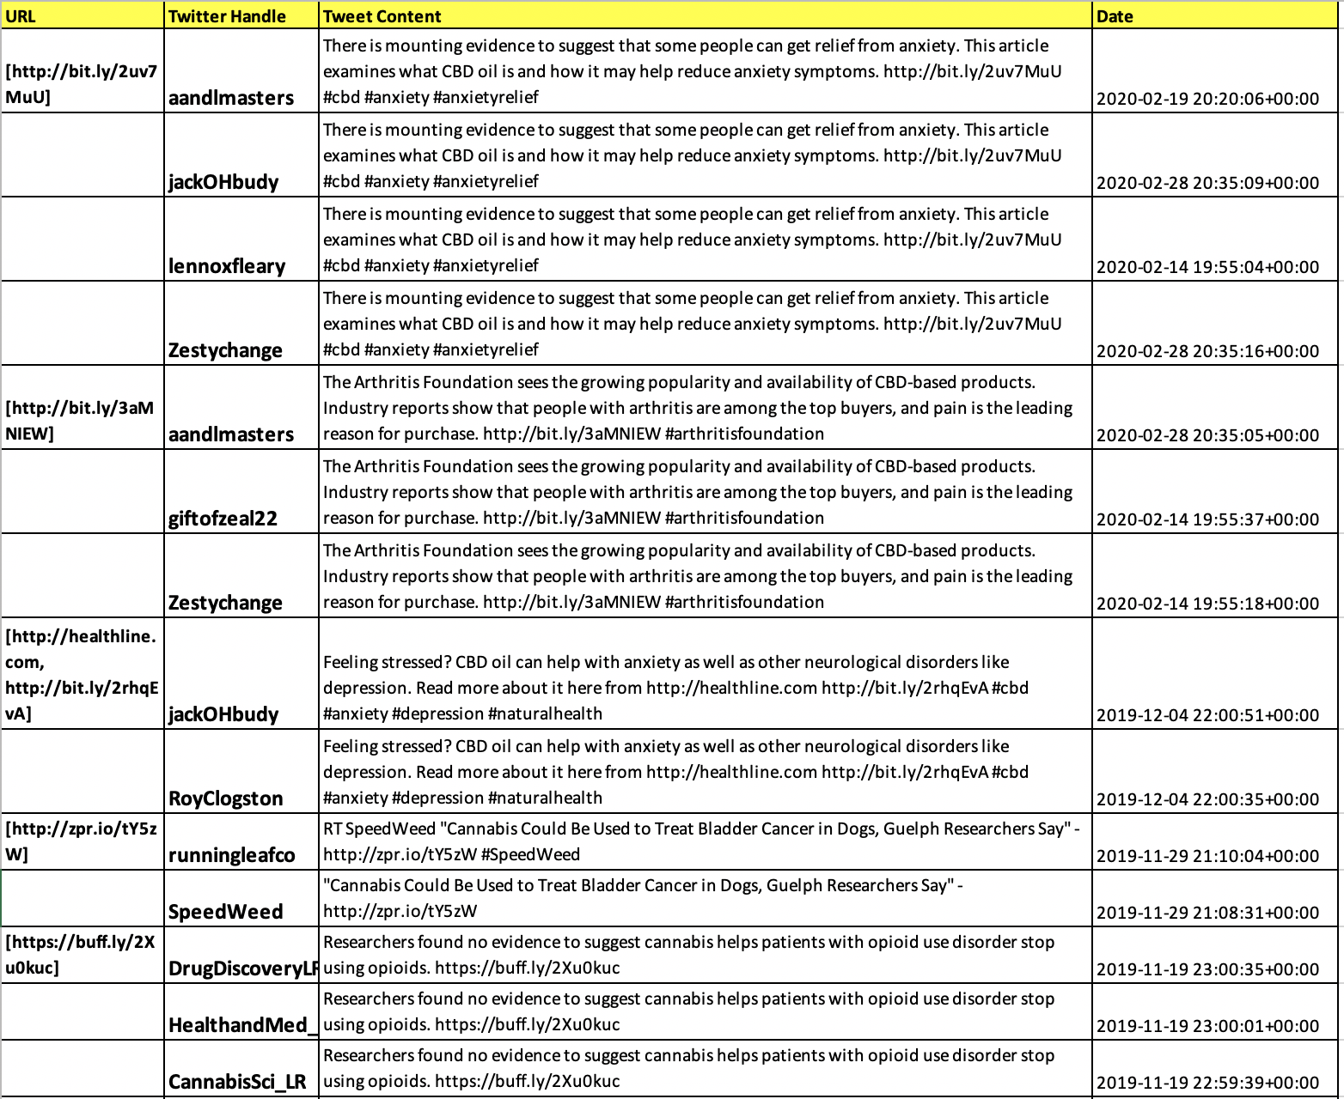
Social BOTS GROUPED BY URL

Slide 27
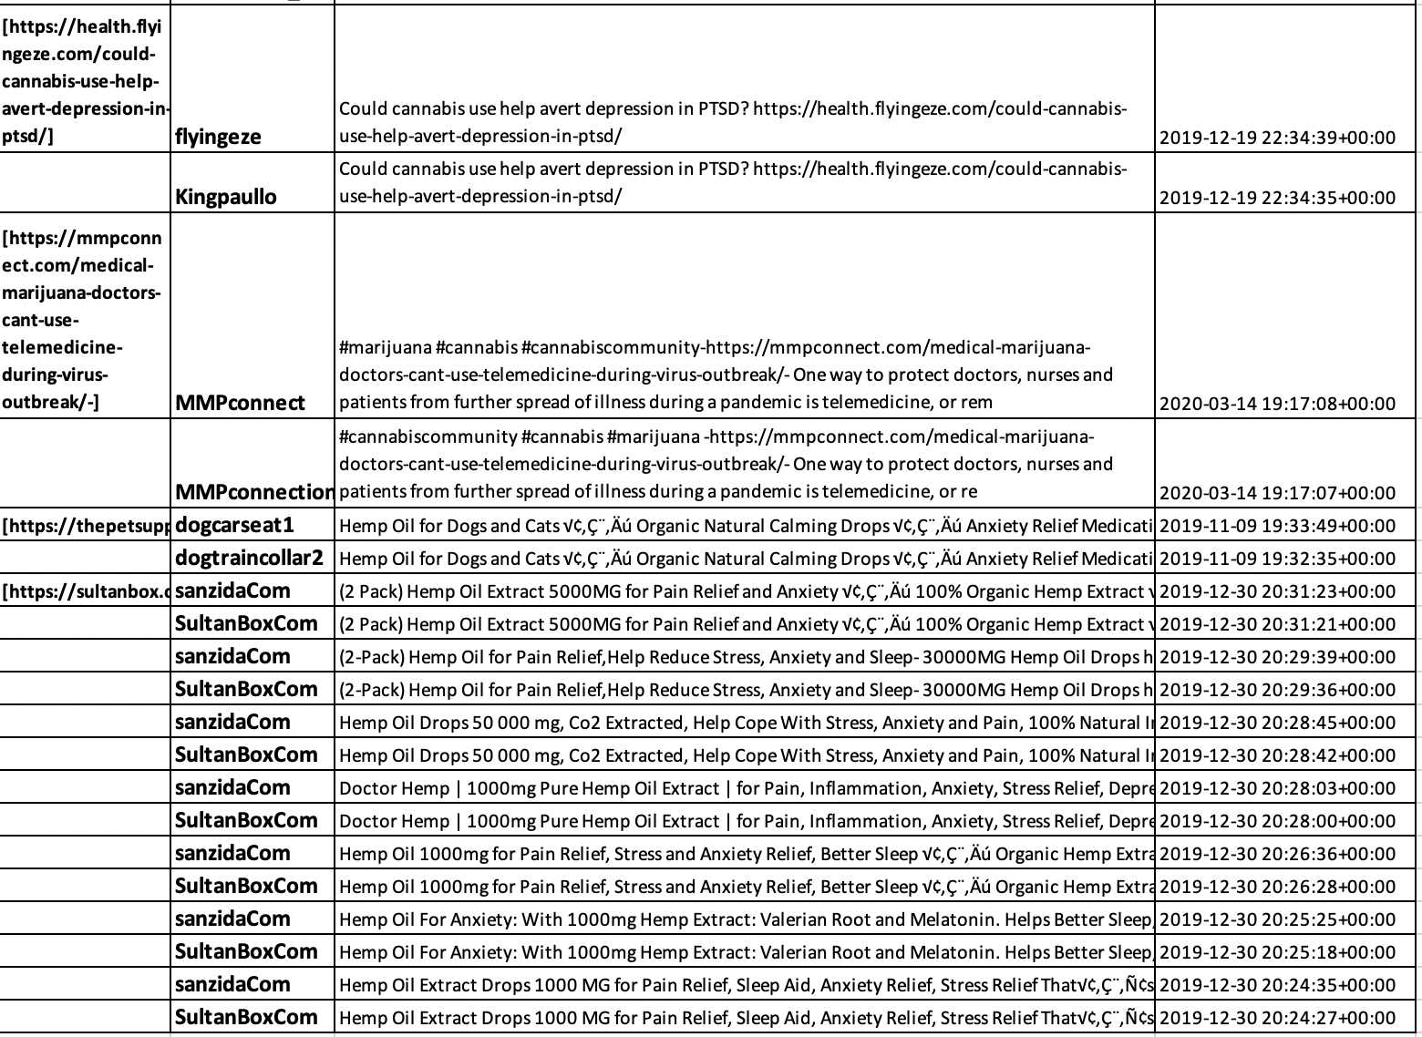

Slide 28
SOURCE ANALYSIS – NETWORK OF BOTS
On further analyzing the tweets of Bot accounts grouped by URLs it was found that certain group of bots tweeted the same content at the same timestamp thus forming a network amongst themselves.
The possible Bot Networks as observed from our data are as follows
Twitter Handle
aandlmasters
jackOHbudy
lennoxfleary
Zestychange
giftofzeal22
Twitter Handle
MMPconnect
MMPconnection
Twitter Handle
sanzidaCom
SultanBoxCom
Twitter Handle
DrugDiscoveryLR
HealthandMed_LR
CannabisSci_LR

Slide 29
Tweets content Analysis
Verified or Unverified content in tweets

Slide 30
Tweets content analysis
Our tweets content analysis included two types of anaylisis :
First : Facts or Not tweets
Second : Promotional tweets

Slide 31
Verified Medical facts how did we choose!
Although it is important to note Cannabis potential medicinal benefits, many claims still lack proper medical investigation.
A lot of published studies in this regard are lacking randomized controlled trials (RCTs) to prove their claims.
We have based our selection of medically proven facts about Cannabis based on the following :
Diseases proven to benefit from cannabinoids based on RCTs, double blinded trials.
FDA approved medicinal cannabinoids.
Research results from National Institute of Health (NIH)

Slide 32
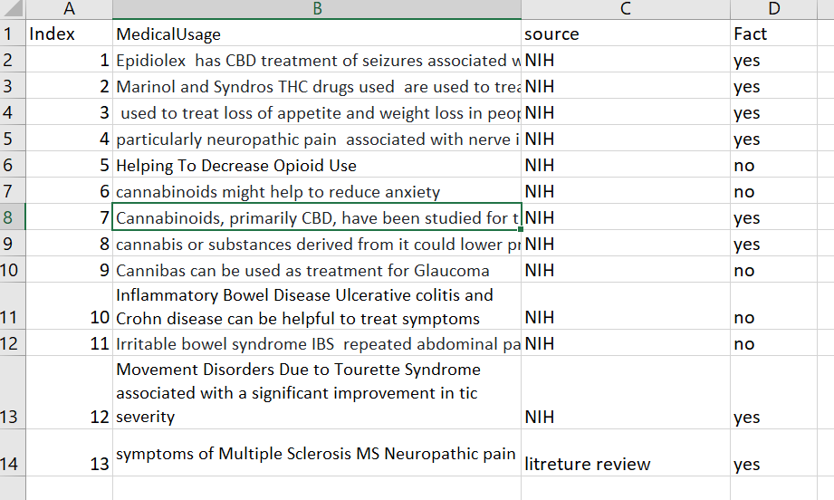
Facts sheet used in our project to Classify tweets
We have collected our data in a spreadsheet with following verified facts.
If the tweet mentions any of the following Medical claim about using Cannabis it will be classifying tweet as “Fact”.
Any tweet that mentions medical claim about using Cannabis other than following facts list will be classified as “Unverified Fact”.

Slide 33
Algorithm for classifying tweets- Facts or Misinformation
Filtered 2587 tweets mentioning medical claims of using Cannabis were filtered using our 3 Bag of Words.
Algorithm is built using Bag of Words approach to classify medical claim tweets into Facts and Misinformation.
Algorithm checks if one of the Medical Condition from Facts sheet appear in the tweet:
If Medical Condition from Fact sheet appears it will check for the corresponding Verified Effect of that Medical condition in the same tweet and classify the tweet as “Fact” if the Verified effect is present.
If any Medical condition or Verified Effect other than one listed in Facts sheet is present in tweet it will classify the tweet as “Misinformation”
30 Tweets out of 2587 Tweets were classified as Facts.
Most factual tweets were about how marijuana helps with symptoms of cancer and chemotherapy.

Slide 34
A demonstration on how the Algorithm classifies tweets!
Example:
Older women with breast cancer use cannabis to alleviate the nausea and vomiting associated with cancer treatments
The algorithm will check if any of Medical condition listed in Facts sheet shown appears in the tweet. Here cancer from Medical Condition appears in the tweet.
Now it will check if Verified Effects next to cancer i.e. either nausea or vomiting appears in the tweet. Here nausea and vomiting both are appearing in the tweet.
So here Medical condition and its corresponding effect from Fact sheet both are present in the tweet so algorithm will classify the tweet as Fact.

Slide 35
Tweets classified as facts by algorithm
Cleaned Tweets | Medical Condition
i once was adamant against legalizing until my mom got cancer and only recovered from the pound weight loss with marijuana we tried everything else we could think of marijuana got her gaining again and has since stopped taking it #to #faster than her hair grew back | weight loss Cancer
new study reveals main reasons older women with breast cancer use cannabis itÃ¢â‚¬â„¢s not nausea cannabis to alleviate the nausea and vomiting associated with cancer treatments is considered one of the medical applications mostÃ¢â‚¬Â¦ #cannabis #marijuana #cbd | nausea and vomiting Cancer
although marijuana can be helpful for certain ailments it is only fda approved at this point for the following cbd analogue for certain juvenile seizure disorders thc analogue for nausea from chemotherapy amp weight loss in aids patients | seizure, nausea in cancer and weight loss in AIDS
Ã¢â‚¬Å“although trials are underway to examine the effectiveness of pharmaceutical cbd for specific conditions including in psychosis few or no clinical studies to date have examined the effectiveness of cbd for depression anxiety tourette syndrome or adhd | tourette syndrome , anxiety
reasons to use blueskybuds hemp oil for dogs amp cats reduces anxiety prevents amp fights cancer can help manage seizures and epilepsy relieves pain increases appetite #dogsofinstagram #dogofinstagram #chien #cbddog #samoyedlife #puppydog #cbdforpets #cbdhealth | seizures,epilepsy, appetite
these rcts which involved patients suggest that medical marijuana may have some benefit in the management of chemotherapy induced nausea hiv related anorexia and neuropathic pain american medical association #ryanslaw | Nausea during cancer chemotherapy and HIV
bathing in cannabis cbd bath bombs to help with fibromyalgia and improving sleep | sleep and fibromyalgia
new cbd research just published shows cbd cream reduces pain in placebo study of neuropathic pain #cbd #cannabis #thc #hemp #cbdoil #cannabiscommunity #weed #marijuana #cannabisculture #cbdhealth #weedporn #cbdlife #vape #cbdheals #hempoil #hightimes | Reduce pain in neuropathic pain
sorry to hear depending on the nature of the convulsions epilepsy seizures this may be one of those classic cases of cbd oil being able to miraculously eliminate up to of seizures within a week of administration dm me pls i would like to help | seizures associated with epilepsy

Slide 36
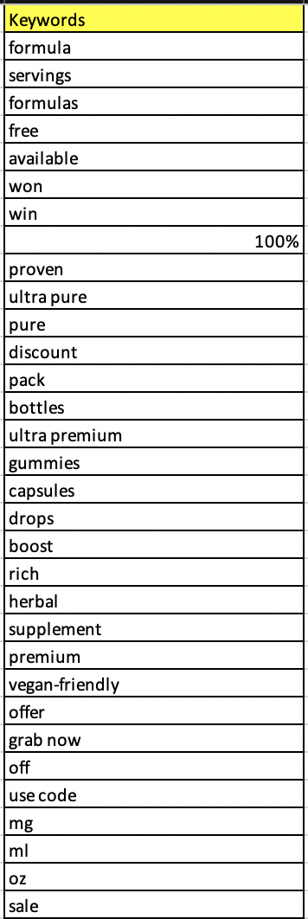
CONTENT ANALYSIS - PROMOTIONAL TWEETS
A classifier was developed in order to filter tweets that made promotional health claims based on keywords
Keywords used – 32 words
Username | Tweet | Bot_or_Not | Promotional/Not Promotional
AmazonBay4u | Cinnamon Hemp Oil Drops for Pain Relief, Stress, Anxiety, Sleep - (4 PACK) http://dlvr.it/RP07C4 | Bot | Promotion

Slide 37
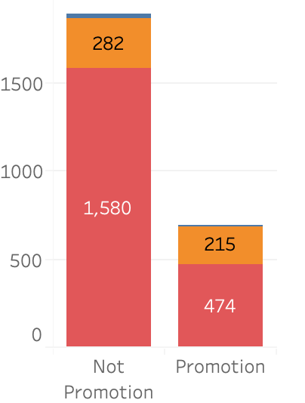
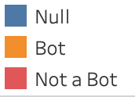
CONTENT ANALYSIS – PROMOTIONAL TWEETS
Out of the total 2551 unique tweets there were 697 Promotional Tweets and 1890 Non-Promotional Tweets.
These Promotional/Non-Promotional Tweets were then cross analyzed with Bot/Non-Bots in the final data of 2551 unique tweets.
Promotional/Not vs Bot/Not
 | Bots (497) | Non-Bots(2094)
Promotional (697) | 215 | 474
Non-Promotional(1890) | 282 | 1580

Slide 38
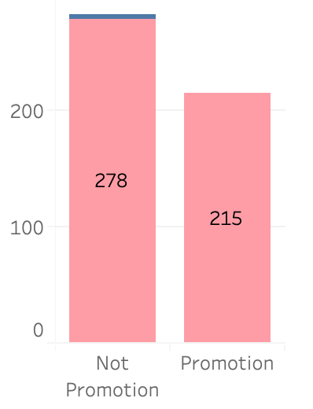
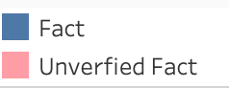
CONTENT ANALYSIS – PROMOTIONAL TWEETS vs. Facts/unverified facts
To further extend our study of the behavior of Bots, we cross analyzed the Promotional/Non-Promotional Tweets made specifically by Bots against the Facts and Unverified Facts regarding the medical use of Cannabis in our dataset.
As per our data, it was observed that all the Promotional Tweets made by Bots included only Unverified Facts and had zero Verified Facts regarding the medical use of Cannabis.
Filtered by Tweets made by Bots
Promotional/Not vs Fact/Not
 | Facts(4) | Unverified Facts(493)
Promotion(215) | 0 | 215
Non-Promotional(282) | 4 | 278

Slide 39
FINDINGS
We found out that approximately 1 % of tweets (3490 tweets) were mentioning Medical claims about using Cannabis out of 378348 tweets mentioning Cannabis keywords. Captured between November 2019- March 2020.
Out of 2588 unique tweets mentioning medical claims of using Cannabis, only1.12 % are Verified Facts and all other are Misinformation (Unverified Facts) regarding Medical usage of Cannabis.
Behaviour of Bots by Volume:
Tweets made by Bots contributed to 23.5% of total 3490 tweets and remaining were made by non bot accounts.
Also there are 2128 unique user accounts which made Health claims regarding the use of Cannabis out of which 12% of user accounts(255 user handles) were bots and remaining 1839 were non-bots accounts.
Behaviour of Bots by Time period:
Bot seems to be most active on Monday which contributed to 28 % of total 822 tweets made by bots. There is no significant difference in tweets made by Bots on other days of week.
Also most of tweets made by bots are in the month of December contributing to 32% of total 822 Bot tweets. For other months frequency of tweets made by Bot accounts is similar.
Bots activity is highest at night and 70 % of Bots make 1 or 2 tweets per day.

Slide 40
FINDINGS
Source Analysis of Bots:
72% of Bots tweets have url in them and there were 10 unique user mentions (@person tagging) and which were having more than 100k followers. It seems that bots which makes user mentions seems to tag popular twitter accounts. Also 27 % of total 3490 tweets are Promotional and all Promotional tweets made by Bots are Unverified Facts regarding Health claims about use of Cannabis

Slide 41
CONCLUSION
We’ve addressed the challenges of analyzing unstructured Tweets’ content by implementing efficient algorithms. As a result, we’ve extracted many valuable information.
Firstly, the proportion of tweets making unverified medical claims regarding the use of Cannabis in twitter is alarmingly high(99%), which has to be addressed as misinformation and repeated use of Cannabis can cause serious health implications.
Secondly, the social bots in twitter often made unverified health claims. Also, our result reveals strong level of association amongst groups of Bots, likely forming networks of Bots. Also, promotional tweets made by Social Bots made unsubstantiated health claims and tried to sell a product.
Focus on these unsubstantiated claims regarding Cannabis use perpetuating in Twitter is essential as it may have serious implications like cannabis dependence and additional health consequences as more and more people are experimenting with Cannabis use in the light of the legalization of medical and recreational use of Cannabis in many states across the US.

